Slide 1
NEOPLASMS Dr. KADUYU DENNIS
DEFINITION
NOMENCLATURE
CHARACTERISTICS OF TUMORS
CANCER EPIDEMIOLOGY
TYPES OF CANCER
CLINICAL FEATURES OF COMMON NEOPLASM
PREDISPOSING FACTORS TO COMMON NEOPLASMS
CARCINOGENESIS
CLASSIFICATIONS OF CARCINOGENS
STAGING CANCER
LABORATORY DIAGNOSIS AND OTHER INVESTIGATIONS OF CANCER

Slide 2
DEFINITION
Neoplasm is an abnormal mass of tissue of which exceeds and persists in the same excessive manner after cessation of the stimulus evoking the transformation.
(pre-molecular era)
OR
Neoplasm is a disorder of cell growth that is triggered by a series of acquired mutations affecting a single cell or its clonal progeny.
(modern era)

Slide 3
NOMENCLATURE
Neoplasms are named based upon 2 factors
On the histological type- Mesenchymal and Epithelial
On behavioral Pattern-Benign and Malignant neoplasm
Epithelial cells
These are cells that line organs ,vessels and cavities providing protection to the body hence neoplasms can arise from them
Mesenchymal cells
These are cells that make up the soft tissue capable of differentiating into any type of smooth muscle, vascular endothelium ,connective tissue ,supporting tissue hence from them we can have soft tissue /connective tissue neoplasms.

Slide 4
BENIGN NEOPLASM
The suffix-oma Denotes a benign neoplasm
Benign Epithelial neoplasm
Benign mesenchymal neoplasm

Slide 5
EXAMPLES OF BENIGN EPITHELIAL TUMORS
CELL OF ORIGIN | BENIGN EPITHELIAL NEOPLASM/TUMORS
Squamous epithelium | Squamous cell papilloma
Transitional epithelium | Transitional cell papilloma
Glandular epithelium | adenoma
Neuroectoderm | Naevus
Hepatocytes | Liver cell adenoma
Placenta( chorionic epithelium) | hydatidiform

Slide 6
EXAMPLES OF BENIGN MESENCHYMAL NEOPLASM/TUMOR
TISSUE OF ORIGIN | BENIGN MESENCHYMAL NEOPLASM
Adipose tissue | Lipoma
Cartilage | chondroma
Bone | Osteoma
Smooth muscle | leiomyoma
Skeletal muscle | rhabdomyoma
Blood vessels | haemangioma
Meninges | Meningioma

Slide 7
NOTE
Although this broad generalization regarding nomenclature of tumors usually holds true in majority of instances there are some exceptions.
EXCEPTIONS
Melanoma –carcinoma of the melanocyte
Hepatoma –carcinoma of the hepatocyte
Lymphoma – malignant tumour of lymphoid tissue
Seminoma - malignant tumour of the testis

Slide 8
MALIGNANT NEOPLASM
Malignant tumors of epithelial origin are called carcinomas
Malignant tumors of mesenchymal origin are called sarcomas
i.e.
Malignant epithelial neoplasm/carcinoma
Malignant mesenchymal neoplasm/sarcoma

Slide 9
MALIGNANT EPITHELIAL NEOPLASM
CELL OF ORIGIN | MALIGNANT EPITHELIAL CARCINOMA
Squamous epithelium | Squamous cell carcinoma
Transitional epithelium | Transitional cell caecinoma
Glandular epithelium | adenocarcinoma
Basal cell layer skin | Basal cell carcinoma
Hepatocyte | Hepatoma
Plancenta(chorionic epithelium ) | Choriocarcinoma

Slide 10
Malignant Mesenchymal neoplasm
CELL OF ORIGIN | MALIGNANT MESENCHYMAL NEOPLASM
Adipose tissue | Liposarcoma
Cartilage | Chondrosarcoma
Bone | Osteosarcoma
Smooth muscle | Leiomyosarcoma
Skeletal muscle | Rhabdomyosarcoma
Blood | Angiosarcoma
Meninges | Invasive meningioma

Slide 11
Nomenclature
Neoplasm
Benign
Malignant
Carcinoma
Sarcoma

Slide 12
SPECIAL CATEGORIES OF TUMOURS

Slide 13
CHARACTERISTICS OF TUMOURS
Characteristics of tumours are described under the following
Rate of growth
Cancer phenotype
Clinical and growth features
Microscopic features
Local invasion(direct spread)
Metastasis (distant spread)
Routes of metastasis
lymphatic spread ,haematologic spread ,and spread along body cavities and natural passages.(read details from harsh mohan)

Slide 14
BENIGN | MALIGNANT
Slow growing | Fast growing
Capsulated | Non capsulated
Non-invasive | Invasive and infiltrate
Do not metastasize | metastasize
Well differentiated | Poorly differentiated

Slide 15
CANCER EPIDEMIOLOGY
Cancer is a growing health problem in Uganda .Cancer affects any part of the body
Common types of cancers in Uganda include,
Prostate cancer, cervical cancer, breast cancer, Kaposis sarcoma , Burkett's lymphoma, colon cancers , cancers of blood, lung cancers ,
Top 3 cancers include, prostate cancer, cervical cancer and breast cancers
Common cancers in men in Uganda
prostate cancer ,esophageal cancer and kaposis sarcoma
Common cancers in women in Uganda
Cervical cancer , breast cancer Kaposi's sarcoma
Common tumors in children
Burkett's lymphoma, Nephroblastoma, neuroblastoma etc
Note ,
the above statistics are bound to change over time

Slide 16
TYPES OF CANCERS
There are more than 100 types of cancer .
Types of cancer are usually named according to;
Organs or tissues where the cancers begin and type of cell they are made of.
Examples ;
Breast cancer starts in the cells of the breast.
Lung cancer starts from cells of the lung
Brain cancer starts in the cells of the brain
ETC

Slide 17
There are also several clinical terms used for certain general types of cancers.
Carcinoma
is a cancer that starts in the skin or tissues that line other organs
Sarcoma
is a cancer of connective tissue such as bones ,muscles, cartilage and blood vessels.
Leukemia
Is a cancer of bone marrow which creates blood cells.
Lymphoma and myeloma
Are cancers of the immune system .

Slide 18
CLINICAL FEATURES OF COMMON NEOPLASMS
Symptoms of neoplasms greatly depend on where the neoplasm is located.
Regardless of the type there some common symptoms of neoplasms
Anemia, shortness of breath, abdominal pain , persistent fatigue, loss of appetite , chills, diarrhea, fevers ,
Constitunal symptoms in lymphomas include
Drenching night sweats , evening fevers and unintentional weight loss of >10% in the past 3 months.
ASSINGMENT
Discuss the clinical features for each of the common cancers in Uganda in men, children and women

Slide 19
PREDISPOSING FACTORS TO COMMON NEOPLASMS
Genetic factors
Racial factors
Environmental and culture
Cigarrete
Alcohol abuse
Alcohol and Tobacco
Cancer of cervix
Penile cancer
Industrial and environmental substances
Certain constituents in the diet
Age
Sex
Premalignant conditions
Hormones

Slide 20
CARCINOGENESIS
Carcinogenesis is the process of conversion of a normal cell to a malignant cell.
Carcinogen is an agent with the capacity to cause cancer.
It is a complex process, the exact details are not very clear.
It is known that the conversion is not spontaneous, but involves many steps and usually takes a long time.

Slide 21
MOLECULAR PATHOGENESIS OF CARCINOGENESIS
Activation of growth promoting oncogenes
Inactivation of cancer suppressor genes
Abnormality of apoptosis regulating genes
Failure of DNA repair
Activation of oncogenes
Point mutation and deletions of RAS in cancer of bladder, pancreas and cholangiocarcinoma
Chromosomal translocation in chronic myeloid leukaemia( 9 to 22) and Burkett lymphoma ( 8 to 14)
Gene amplification that is increase in number of gene copies in breast and ovarian carcinoma.

Slide 22
CLASSIFICATIONS OF CARCINOGENS
Biological carcinogens
Physical carcinogens
Chemical carcinogens
Preservatives

Slide 23
BIOLOGICAL CARCINOGENS
Parasites- schistosoma haematobium with urinary bladder carcinoma, liver flukes with carcinoma bile ducts.
Fungus- aspergillus flavus with hepatocellular carcinoma thru aflatoxin.
Bacteria- Helicobacter pylori with gastric carcinoma and gastric lymphoma.
Viruses- HPV 16,18, 45 with carcinoma cervix and carcinoma penis, EBV with Burkett's lymphoma and nasopharyngeal carcinoma, HBV with hepatocellular carcinoma etc.

Slide 24
PHYSICAL CARCINOGENS
Ultra violet light main source sun cause DNA damage. In most people, the damage is repaired, but in conditions like xeroderma pigmentosum, repair is defective, and hence cancer of skin.
Ionising radiations E.g. xrays- DNA damage and subsequent cancer of skin, lung, thyroid, breast and leukaemia.
Non radiations like burns etc.

Slide 25
PRESERVATIVE CARCINOGENS
Sodium benzoate
shows negative side effect when mixed with ascorbic acid(vitamin c) studies indicate that it then turns into benzene a known carcinogen
Sodium nitrate
A main preservative of meat , the body coverts the nitrate into N-nitroso which has been associated to cause cancer.
Potassium bromate
This is an oxidizing agent that has been used as a food additive mainly in bread making process –active oxygen radicles generated from potassium bromate is implicated to have carcinogenic effects.

Slide 26
CHEMICAL CARCINOGENS
Chemicals may be initiators or promoters. Initiation is sudden, irreversible and permanent. Initiators may be direct or indirect.
Direct initiators are directly carcinogenic. Most are anti cancer drugs, e.g. Cyclophosphamide, chlorambucil, busulfan. Cause leukaemia or lymphoma.
Indirect are not directly carcinogenic, but requires metabolic conversion, for example, polycyclin, aromatic hydrocarbons (found in tobacco, smoke, smoked animal products) associated with cancers of lungs, skin, oral cavity and sarcomas.
Aromatic amines( β-naphthylamine and benzidines) and azo-dyes associated with bladder and liver cancer.

Slide 27
STAGING CANCER
Grading or staging of cancer( which is better?)
Grading of cancer denotes the level of differentiation of tumour cells and presumably correlation to aggressive characteristic of the neoplasm.
Staging of cancer has assumed great importance in selection of the best form therapy for the patient
HENCE
Staging has proved to be of greater clinical value than grading

Slide 28
Staging is a way of documenting the extent of spread of tumours.
It is based on physical examination of the patient, and may be supplemented by other investigations.
It is very important for deciding mode of treatment as well as predict prognosis.
There are three ways of staging tumours, by using numbers e.g I,II,III,IV, or letters e.g A,B,C or the TNM staging system.
The staging is based on size of primary tumour, presence of tumour in lymph nodes and presence of tumour in distant areas.

Slide 29
TNM STAGING
The TNM staging varies for each specific form of cancer but there are general principle
T signifies size of primary tumour e.g. ( <2cm ,>2cm but <5cm then >5cm)
N signifies the number of draining lympnodes infiltrated by tumour
M signifies presence of distant metastases.

Slide 30
TNM - Staging of tumors
Stage
Definition
Tis
In situ, non-invasive (confined to epithelium)
T1
Small, within primary organ/site
T2
more invasive extension out of site/location.
T3
beyond margins of primary organ site
T4
Very large / spread to other region/adjacent organs
N0
No lymph node involvement
N1
Regional lymph node involvement
N2
Extensive regional lymph node involvement
N3
More distant lymph node involvement
M0
No distant metastases
M1
Distant metastases present

Slide 31
Stage Carcinoma Cervix
Staging with numbers
Stage I tumour confined to cervix only
Stage II tumour has spread to proximal 2/3 of vagina
Stage III tumour has spread to distal 1/3 of vagina.
Stage IV tumour has spread to rectum or urinary bladder or other distant sites.

Slide 32
Staging Rectal carcinoma
Staged using letters, A,B or C.
Stage A tumour confined to intestinal wall
Stage B tumour has penetrated the whole thickness of intestinal wall.
Stage C there are lymph node metastases.
Meaning of ABC staging
A=early stage tumour
B=intermediate stage tumour
C=advance stage tumour, that is, late stage.

Slide 33
TNM staging (Carcinoma breast)
T size of primary tumour
T1 primary tumour less than 2 cm in greatest dimension.
T2 primary tumour more than 2cm but less than 5cm.
T3 primary tumour greater than 5cm.
T4 primary tumour has spread to chest wall or ulceration of skin
N number of draining lymph nodes infiltrated by tumour
N0 N1, N2
M presence of distant metastases
M0 no evidence of distant metastases
M1 evidence of distant metastases
Mx evidence of distant metastases cannot be ascertained

Slide 34
TNM Staging carcinoma penis
T1: Tumour invades subepithelial connective tissue.
T2: Tumour invades corpus spongiosum or corpus carvenosum.
T3: Tumour invades urethra or prostate.
T4: Tumour invades other distant structures.
Nx: lymph node involvement cannot assessed.
N0: No lymph node involvement.
N1: Single superficial inguinal lymph node involvement.
N2: Multiple or bilateral superficial inguinal lymph nodes involved.
N3: Deep inguinal or pelvic lymph nodes involved.
Mx: Distant metastases cannot be assessed.
M0: No distant metastases.
M1: Distant metastases present.
So a tumour could be staged as T1NxMx or T2N2Mx etc.

Slide 35
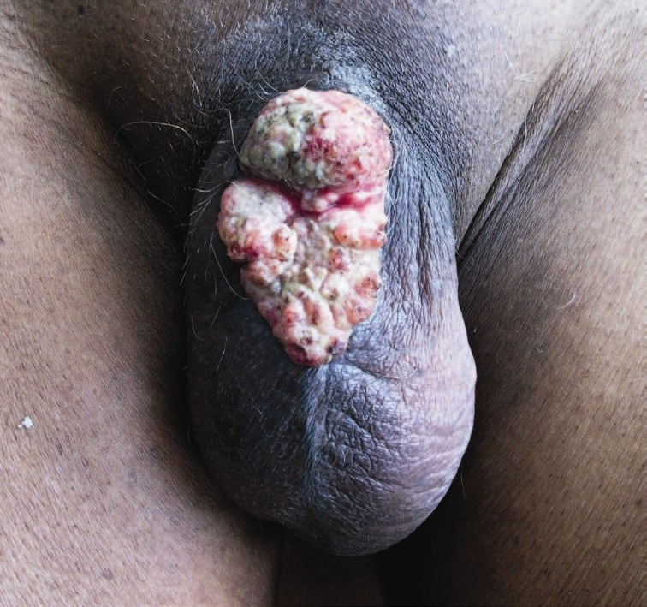
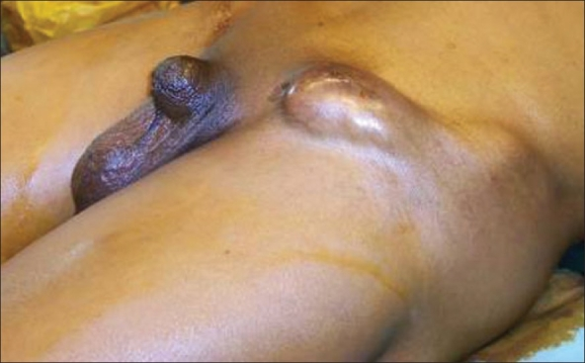
Advanced Carcinoma penis
Penis eaten away by cancer
Secondary carcinoma in lymph node

Slide 36
Relationship between staging systems
Stage I = T1N0M0 = Stage A
Stage IV = T4N4M1 = Stage C

Slide 37
TUMOR DIAGNOSIS
Laboratory diagnosis and other investigations
Overview
History and physical examinations
Laboratory analysis-Tumour markers
Radiographic analysis-X-ray, ultrasound scan , CT scan , MRI
Biopsy -histopathology
Cytology –Pap smear (ca cervix) ,FNAB(fine needle aspiration procedure involving aspirating cell and attendant fluid with a needle followed by cytology examination –common for palpable lesions breast, thyroid and lymphnodes

Slide 38
TUMOUR MAKERS
Tumour markers are biochemical indicators of the presence of tumour .
They include cell surface antigen ,cytoplasmic proteins , enzymes and hormones.
NOTE
Tumour markers cannot be considered as primary modalities for diagnosis of cancer and thus act as supportive laboratory.
CA-125 –Ovarian cancer
ALP(Alpha fetal Protein)
Elevated in –hepatocellular carcinoma ,non- seminomatous germ cell tumours of the testis
Non neoplasmic conditions
hepatitis ,pregnancy, cirrhosis
CA-153-Breast cancer

Slide 39
CEA
High in Gastrointestinal ,pancreas
Non-neoplasmic – hepatitis, ulcerative colitis , crohns diseases
PSA –Prostate cancer
Beta -HCG –Trophoblastic tumour e.g. molar pregnancy

Slide 40
Prognosis of tumours
Type of tumour, benign better than malignant.
Grade of tumour, well differentiated (grade 1) better than poorly differentiated (grade 3).
Stage of tumour, early stage (e.g. T1) better than late stage (e.g. T4).

Slide 41
Survival
Treatment of malignant tumours may lead to eradication of the tumours with the patient living for sometime.
When the tumour has responded well to the treatment, the patient is then said to be in remission (not cured).
When the tumour recurs after treatment, it is called relapse.
Many times survival of patients with malignant tumours are talked of in terms of one year or five years survival, as percentage.

Slide 42
QUESTIONS
Define neoplasia
Discuss the differences between benign and malignant neoplasm
What are the etiologic factors in carcinogenic
Discuss the clinical features of neoplasm
How is the diagnosis of cancer made in laboratory
Which of the following describes a benign arising from skeletal muscle
A,leiomyoma
B, papilloma
C, Rhabdomyoma
D,Leiomyosarcoma
E, Rhabdomyosarcoma

